Slide 1
MODULE 3
Robot configurations-PPP, RPP, RRP, RRR; features of SCARA, PUMA Robots; Classification of robots based on motion control methods and drive technologies; 3R concurrent wrist;
Classification of End effectors - mechanical grippers, special tools, Magnetic grippers, Vacuum grippers, adhesive grippers, Active and passive grippers, selection and design considerations of grippers in robot.

Slide 2
Robot configurations-PPP, RPP, RRP, RRR
Already delt in module I

Slide 3
Grippers
Grippers are end-effectors which are used to grasp an object or a tool and hold it.
Tasks required by the grippers are to hold work pieces and load/unload from/to a machine or conveyer.
Grippers can be mechanical in nature using a combination of mechanisms driven by electric, hydraulic, or pneumatic powers.

Slide 4
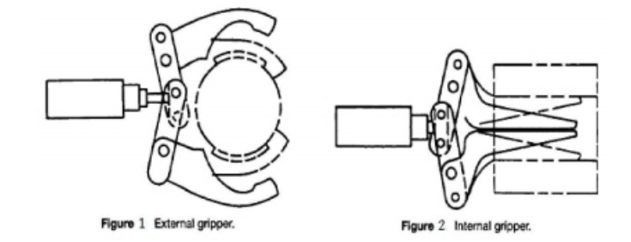
Grippers
Grippers can be classified based on
The principle of grasping mechanism.
For example, grippers can hold with the help of suction cups, magnets, or by other means. A gripper is then accordingly referred to as pneumatic gripper, magnetic gripper, etc.
How it holds an object, i.e. based on grasping the object on its exterior (external gripper) or interior (internal gripper) surface.

Slide 5
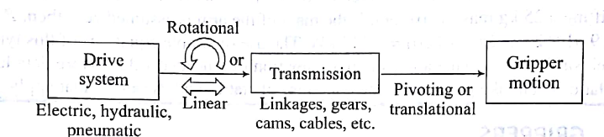
Mechanical Grippers
Mechanical grippers have their jaw movements through pivoting or translational motion using a transmission element, e.g., linkages or gears, etc.
The gripper can be of single or double type. While the former has only one gripping device at the robot's wrist, the latter type has two. The double grippers can be actuated independently and are especially useful in machine loading and unloading.

Slide 6
Single and Double Gripper
Suppose a particular job calls for a raw part to be loaded from a conveyor onto a machine and the finished part to be unloaded onto another conveyor.
With a single gripper, the robot would have to unload the finished part before picking up the raw part. This would consume valuable time in the production cycle because the machine would remain idle during these handling motions.

Slide 7
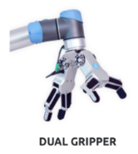
Single and Double Gripper
With a double gripper, the robot can pick up the part from the incoming conveyor with one of its gripping devices and have it ready to exchange for the finished part on the machine.
When the machine cycle is completed, the robot can reach in for the finished part device, and insert the raw part into the machine with the other grasping device.
The amount of time spent in changing the parts of the time to keep the machine idle is minimized.

Slide 8
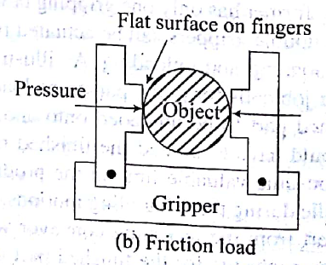
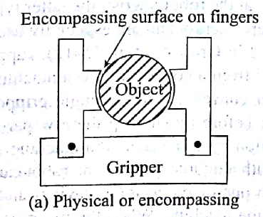
Mechanical Grippers
A gripper uses its fingers or jaws to hold an object,
The function of a gripper mechanism is to translate some form of power input, be it electric, hydraulic or pneumatic, into the grasping action of the fingers against the part.
There are two ways a gripper can hold an object,
By physical constriction as shown in Fig. a , Or
By friction, as demonstrated in Fig. b
In the former case, contacting surfaces of the fingers are made of approximately the same shape of the part geometry, while in the latter case the fingers must apply sufficient force to retain the part against gravity or accelerations.
The friction method of holding a part is less complex and hence less expensive.

Slide 9
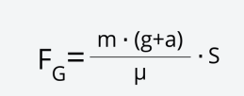
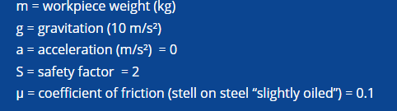
Gripping force in Frictional Gripper
Note: Safety factor is within the range 2 to 3

Slide 10
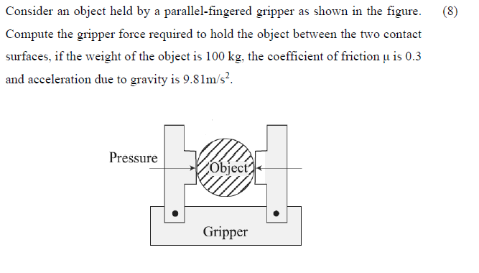
KTU examination question:

Slide 11
The motion of the fingers in mechanical grippers is obtained by means of any of the following transmission elements:
Linkage
Gear and rack
Cam,
Screw and
Cable and pulley
This is illustrated in Figures in the Next slide

Slide 12
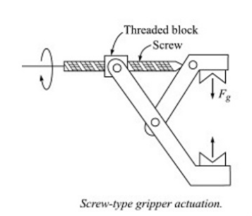
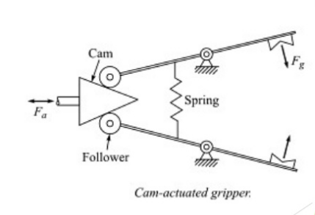
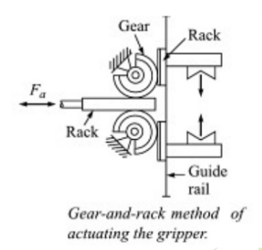
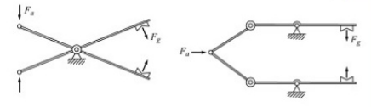

https://www.youtube.com/watch?v=549zRelFEjI

Slide 13
The final gripping action of the fingers is, however, achieved by one of the following means
Pivoting Movement- In this arrangement, the fingers rotate about fixed pivot points on the gripper to open and close. The motion is usually achieved by some kind of linkage mechanism.
Translational -In the translational or linear motion, the fingers open and close by moving parallel to each other.

Slide 14


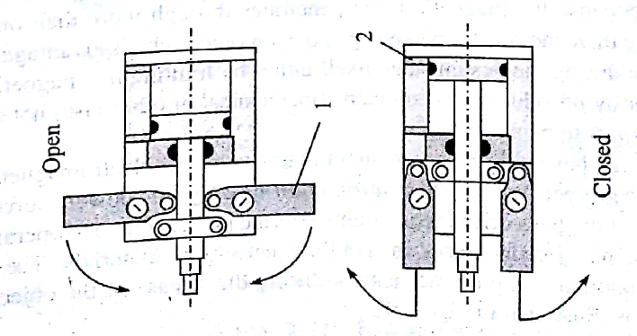
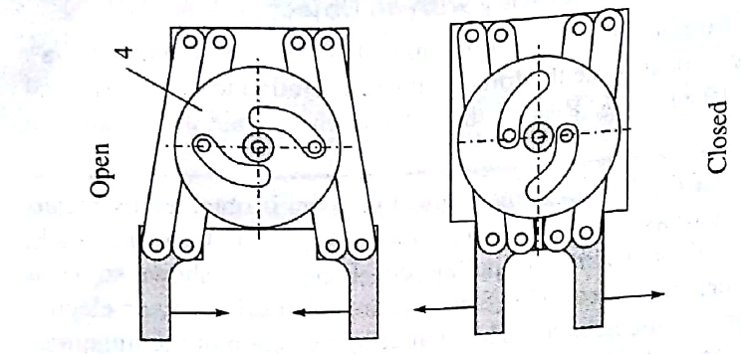
Pivoting Movement
2. Pneumatic cylinder
TranslationalMovement

Slide 15
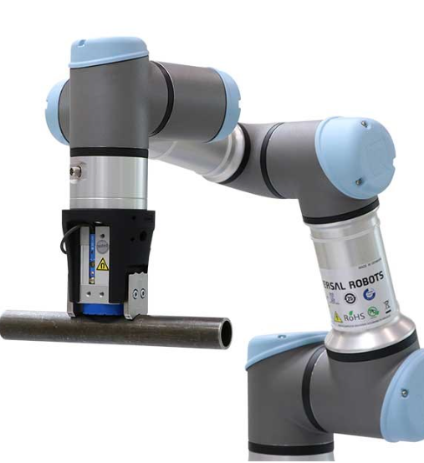
Magnetic Grippers
Unlike mechanical grippers, the principle of a magnetic gripper is based on the magnetic property of a gripper. Hence, they can be used only for ferrous objects.
They have the following advantages:
Variations in object sizes can be tolerated.
Operations are very fast.
Require only one surface to hold an object.

Slide 16
Magnetic Grippers
The disadvantages with magnetic grippers are,
The difficulty to pick thin sheets one at a time because the magnetic force penetrates through more than one sheet. As a result, more than one sheet is picked up.
To overcome such disadvantages, one needs to take care during the design stage itself either by limiting the magnetic force by the gripper or by introducing some means (mechanical or otherwise) not to allow more than one sheet to be picked up.

Slide 17
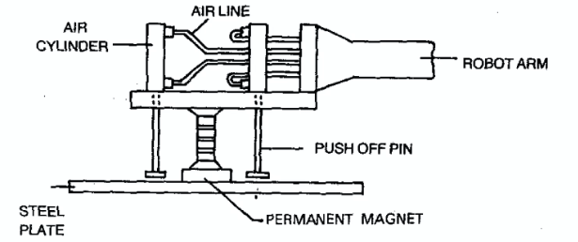
Magnetic grippers can have either (i) permanent magnets, or (ii) electromagnets.
While electromagnetic grippers are easy to control requiring only a dc power source, grippers with permanent magnets do not require any external power source to operate the magnets. Besides, no electric sparks in handling hazardous materials. They however, require an external stripping mechanism during the release of the object. One such mechanism is illustrated in Fig.

Slide 18
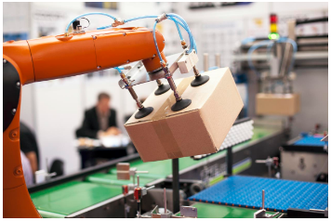
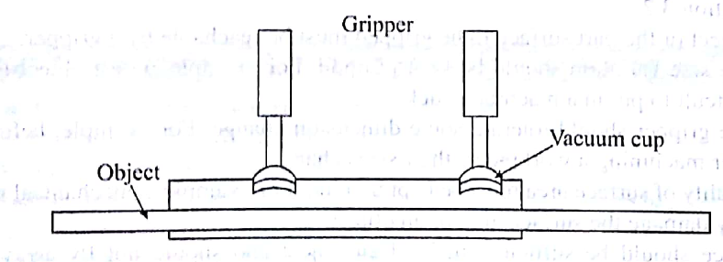
Vacuum Grippers
Such grippers are suitable to handle large flat objects. The material of an object is of no concern with vacuum gripers, except that the object's surface should not have any holes.
An example of vacuum gripper which uses suction cups made of elastic materials is shown in Fig.
For a vacuum gripper, lifting capacity can be determined from the negative pressure and the effective area of the cups as
f = p A
where f is the force on lift capacity, p is the negative pressure, and A is the total effective area of the suction cups

Slide 19
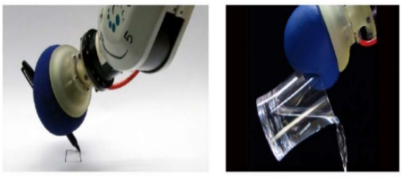
Adhesive Grippers
An adhesive gripper is a robot end effector that grasps objects by literally sticking to them.
In its most primitive form, this type of gripper consists of a rod, sphere, or other solid object covered with two-sided tape.

Slide 20
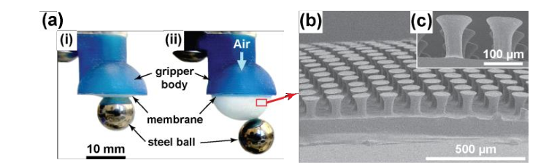
Adhesive Grippers
One of the limitations is that the adhesive substance loses its effectiveness with repeated use. Hence, it has to be continuously fed like a mechanical typewriter's ribbon which needs to be attached to the robot's wrist.
Fig. Gripping concept and fabrication of the GeckoGripper: (a) Photographic image of the GeckoGripper prototype manipulating a 12.7 mm in diameter steel ball. (b) Scanning electron microscope (SEM) image of a cross-section of the GeckoGripper. (c) SEM image of micro-fibers with mushroom-shaped tip endings.

Slide 21
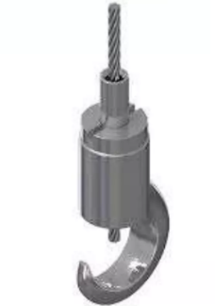
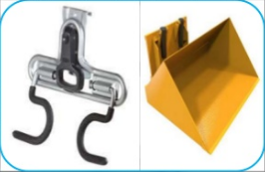
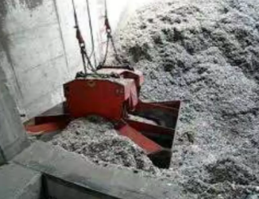
Hooks, Scoops and Others
There exist other types of gripping devices, e.g., hooks, scoops or ladles, inflatable devices, etc., based on the need of item to be handled
Hooks and scoops are the simplest type of end effectors that can be classes as grippers.
A scoop or ladle is commonly used to scoop up molten metal and transfer it to the mould.
A hook may be all that is needed to lift a part especially if precise positioning in not required and if it is only to be dipped into a liquid
Scoops
Hooks

Slide 22
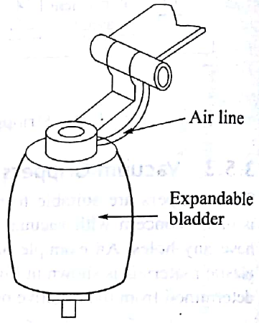

Expandable bladder gripper
A bladder or bladder hand is a specialized robotic end effector that can be used to go pick up and move rod shaped or cylindrical objects –
The main element of the gripper is an inflatable donut shaped or cyindrical sleeve that resembles the cuff used in blood pressure measuring apparatus.
The sleeve is positioned so that it surrounds the object to be gripped and then the sleeve is inflated tight enough to complete the desired task.
The pressure exerted by the sleeve can be measured and regulated using force sensors.

Slide 23
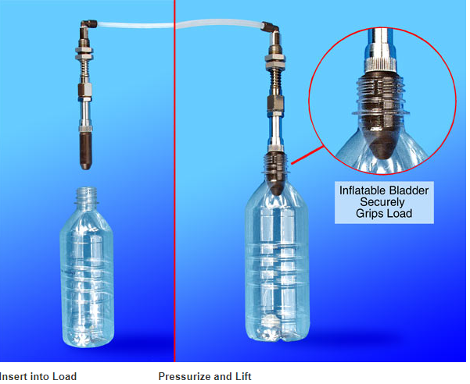
Expandable bladder gripper

Slide 24
https://www.youtube.com/watch?v=JiAp9XFmEYg

Slide 25
Active and Passive Grippers
Passive:
Passive grippers that can hold parts, but cannot manipulate them or actively control the grasp force
Most end effectors in use today are passive; they emulate the grasps without manipulating it in the fingers.
However, a passive end effector may be equipped with sensors, and the information from these sensors may be used in controlling the robot arm.

Slide 26
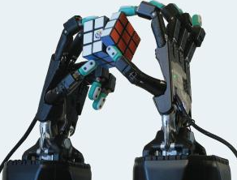
Active and Passive Grippers
Active :
Active grippers are servo grippers and dexterous robot hands found in research laboratories and tele-operated applications
Servo-controlled end effectors provide advantages for fine motion tasks.
In comparison to a robot arm, the fingertips are small and light, which means that they can move quickly and precisely.
The total range of motion is also small, which permits fine-resolution position and velocity measurements.

Slide 27
Selection and design considerations of Grippers
One needs to decide the drive system.
In fact, in an industrial scenario where electric and - pneumatic power sources are easily available, one needs to decide the type.
If fast but not so accurate motion is desired then pneumatic should be preferred.
For heavy objects, certainly one must prefer hydraulic.
Object or the part surface to be gripped must be reachable by the gripper.
During machining operations, there will be a change in the work part size. As a result, the gripper must be designed to hold a work part even when the size is varied.
The gripper should tolerate some dimension change. For example, before and after machining a work piece, their sizes change.

Slide 28
Selection and design considerations of Grippers
Quality of surface area must be kept in mind. For example, a mechanical gripper may damage the surface area of an object.
Force should be sufficient to hold an object and should not fly away while moving with certain accelerations. Accordingly, the materials on the surfaces of the fingers should be chosen.
The gripper must hold the larger area of a work part if it has various dimensions, which will certainly increase stability and control in positioning.
The gripper can be designed with resilient pads to provide more grasping contacts in the work part. The replaceable fingers can also be employed for holding different work part sizes by its interchangeability facility

Slide 29
Selection and design considerations of Grippers
It is difficult to find out the magnitude of gripping force that a gripper must apply to pick up a work part. The following significant factors must be considered to determine the necessary gripping force:
Consideration must be taken to the weight of a work part.
It must be capable of grasping the work parts constantly at its centre of mass.
The speed of robot arm movement and the connection between the direction of movement and gripper position on the work part should be considered.
It must determine either friction or physical constriction helps to grip the work part.
It must consider the co-efficient of friction between the gripper and work part.

Slide 30
SCARA – Selective Compliant Assembly Robot Arm
SCARA is also called as Selective Compliant Articulated Robot Arm.
It is a simple articulated robot which can perform assembly tasks precisely and fast.
SCARA is most adept in pick and place operations in any assembly line in industries with speed as well as precision.
SCARA is more or less like a human arm ,the motion is restricted horizontal sweeping and vertical movement, it cannot rotate along an axis other than vertical.
https://www.youtube.com/watch?v=97KX-j8Onu0

Slide 31
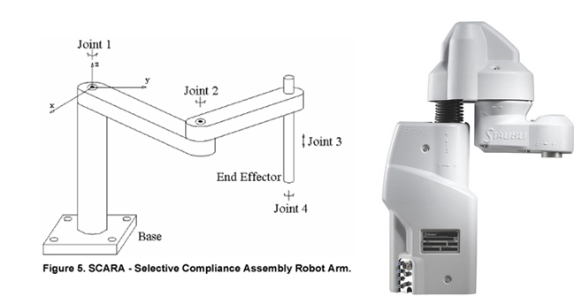

Slide 32
PUMA-(Programmable Universal Machine for Assembly) Robots
PUMA is the most commonly used industrial robot in assembly, welding operations and university laboratories.
PUMA resembles more closely to the human arm than SCARA.
PUMA has greater flexibility than SCARA but with the increased compliance comes the reduced precision.
PUMA is preferably used in assembly applications which do not require high precision, such as, welding and stocking operations.

Slide 33
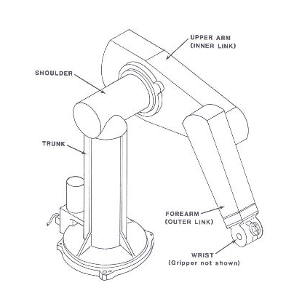
Structure of PUMA
PUMA is an articulated robot with a chain of members connected with each other through revolute or rotary joints as that in SCARA but the difference is the orientation of the axes of the joints.
In PUMA not all the joints are parallel; the second joint from the base is orthogonal to the other joints. This makes PUMA compliant in XY as well as in Z direction.
PUMA has six degree of freedom. Each rotary joint is actuated by DC servomotors and accompanying gear trains.
The flexibility of the PUMA makes it capable of being taught to perform various tasks.
https://www.youtube.com/watch?v=tjOhGqOHfhg&feature=emb_logo

Slide 34
Classification of Robots based on Drive Technologies
Classification is characterized by the nature and type of their drive technology.
Electric robot employs DC servo motors or stepper motor. These robots have the advantage that they are clean and relatively easy to control.
A hydraulic robot is preferred for tasks that require a large load carrying capacity. Care and maintenance is required to handle leaks and fluid compressibility problems.
For high speed applications, a pneumatic robot is often preferred. These robots are generally clean, but can be hard to control due to challenges associated with air compressibility.

Slide 35
Classification of Robots based on motion control methods
Point to point motion control Robot
The robot arm moves from one desired point to the next without regard to the path taken between them.
The actual path taken may be the result of a combination of the arm link movements calculated to provide the minimum travel time between the points.
Continuous path control(CP) control robot
A robot moves along a continuous path with specified orientations.
Signals from the sensors located at the joints are constantly monitored by the Robot controller for appropriate motion control.

